Slide 1
Progressive Testing to Meet the Performance Imperative
Considerations for verification and validation in DevOps pipelines
bit.ly/addo18-progressive-testing

Slide 2

Paul Bruce @paulsbruce linkedin.com/in/paulsbruce paulsbruce.io Sr. Performance Engineer, Neotys Founder, Growgistics IEEE 2675 Working Group Product strategy, automation eng Boston DevOps, Mobile Tea, NADOG

Slide 3
What’s covered?
“Performance Imperative”
“Progressive Testing”
References & Reading

Slide 4
“The Performance Imperative”
Time is limited.
All systems are finite, constrained by their inability to access the future.
Risk is a function of time and decisions.

Slide 5
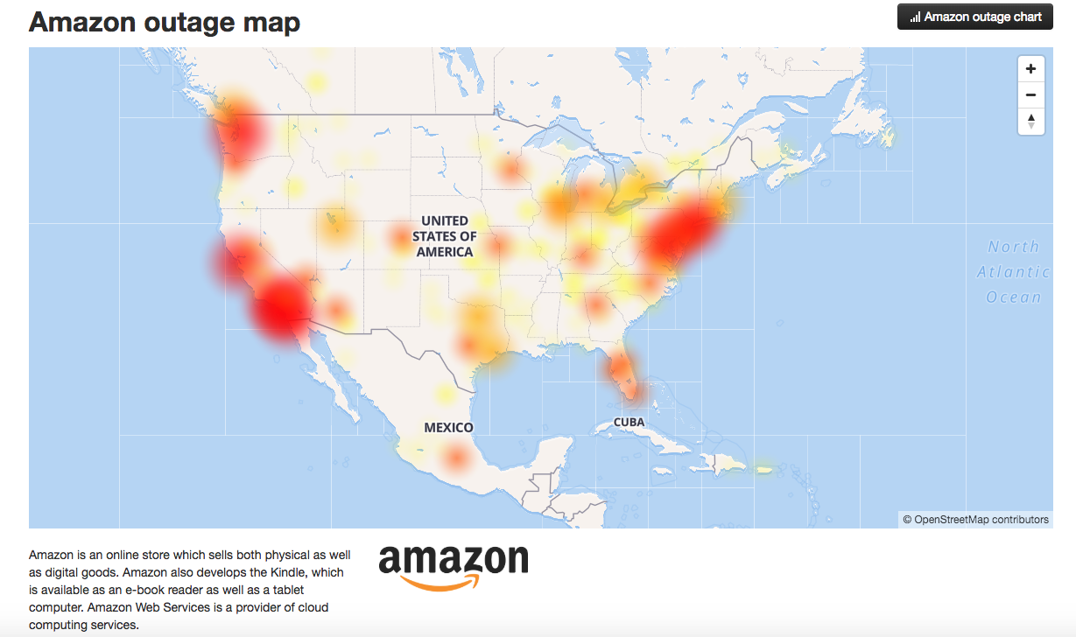
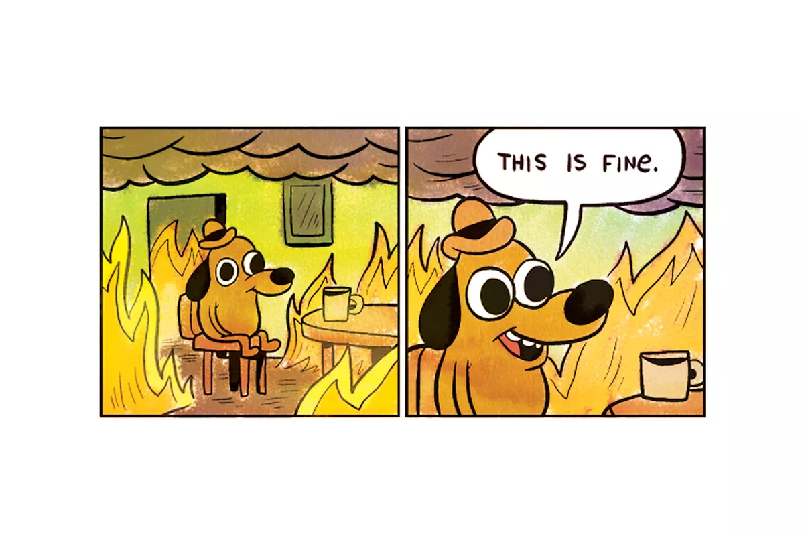
Everyone has this problem

Slide 6
Performance Feedback in Practice
Late stage/cycle testing still prevails
Never the same as production actuals
Code, configuration, and architectural problems
Cross-domain expertise and collaboration

Slide 7
How do SREs quantify performance?
ref: google.com/sre
SLI - Service Level Indicator
quantitative measure...level of service
SLO - Service Level Objective target value or range of SLI(s) measurement
SLA - Service Level Agreement contract with users...consequences

Slide 8
“Performance” Risk Beyond the System
Rework on architectural and operational issues
Delayed feedback → context switching, velocity
Unplanned infrastructure expenses #FinOps
Customer and employee productivity decrease

Slide 9
Performance Across Perspectives in DevOps
{
“Fast” is expected and subjective
Connectivity complexity
Too slow == move on
User Experience
{
Easy to push faulty code
Fast feedback, or, re-work
Emergent behaviors hard to see
Developer Experience
{
Infra changes all the time
Risk in new deployment models
Scalability isn’t free
Operations Experience

Slide 10
Where do we go next?

Slide 11
“Progressive Testing”
Diligent engineers optimize for forward over backward motion. Complexity increases over time. Speed of feedback dictates frequency.

Slide 12
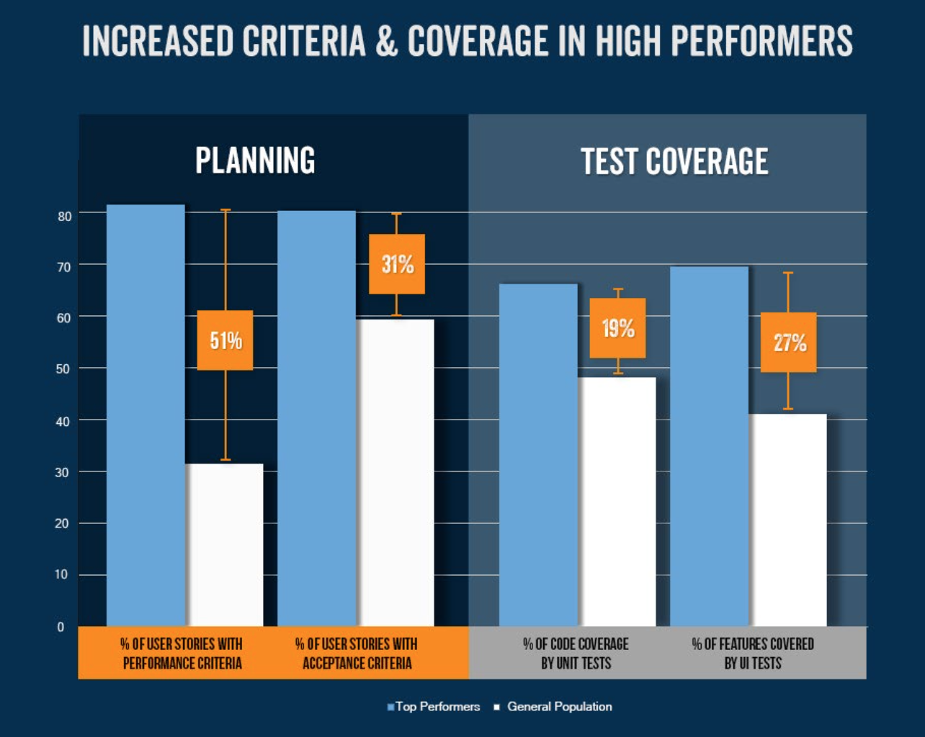
Market “leaders” build quality in
2017 study:
Release every other day (not 1000x per day); 2x user stories w/ performance criteria
bit.ly/performance-feature
How to “bake performance in” to user stories?
“Back of card” / DoD - performance criteria
“Think 4th dimensionally” → Time
Concerns and guidelines, not testing performed
Performance-specific:
Concurrency: “how many at the same time?”
Conditions: “which devices from where?”
Capacity: “what resources will this take?”

Slide 13
The Modern Feedback Mantra
#ShiftThis
{
Small parts (components, APIs) first, then Gestalt
Many contributors and skill sets
App code and test code equal citizens
Early
{
Automate by default, manual only when necessary
Radiate information, good decision autonomy
Matching clock speeds for development and testing
Often
{
Same skills for API and end-to-end testing
Minimize “toil” and potential for failure
Flexible to the changing technology landscape
Easy

Slide 14
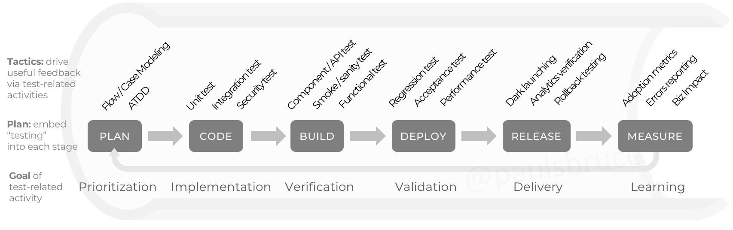

Progressive Testing Across the Pipeline
For:
Feature X… API update Y… Patch N...
Q: What are the “testable moments”?
Radiated Information
Time budget for testing:
Days
Weeks
seconds
minutes
hours

Slide 15
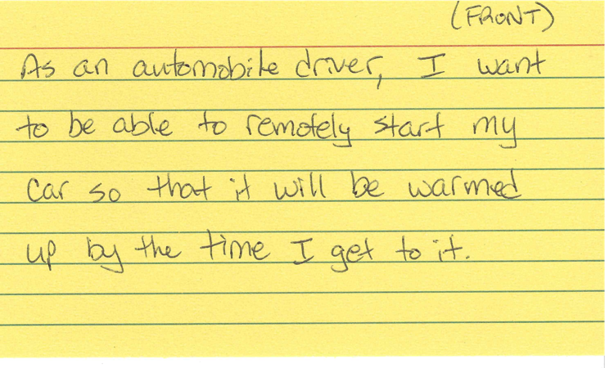
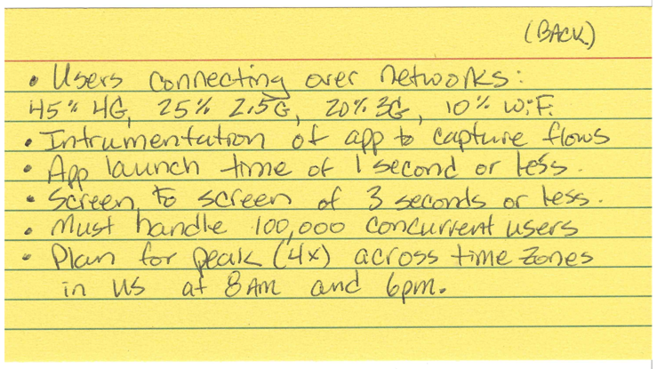
Start by Capturing Details
techbeacon.com/how-build-performance-your-user-stories
Todd DeCapua - @appperfeng

Slide 16

The Real “Key” Performance Metrics
SLO
SLI
...are in how you move from reactive to proactive.
Service Level Indicators
Golden Signals: latency, traffic, errors, saturation
Match SLO and granularity (monitoring interval) of percentiles
Early cascade signals: reduced cache hit rate, queue lengths, resource starvations
“Contributing Factors” from prod; → Construct a test!!! → feedback
Service Level Objectives
What are the anticipated peaks and valleys of demand vs. actuals?
How much/often can service be degraded to maintain order?
How should we refactor learnings from prod into planning processes?

Slide 17
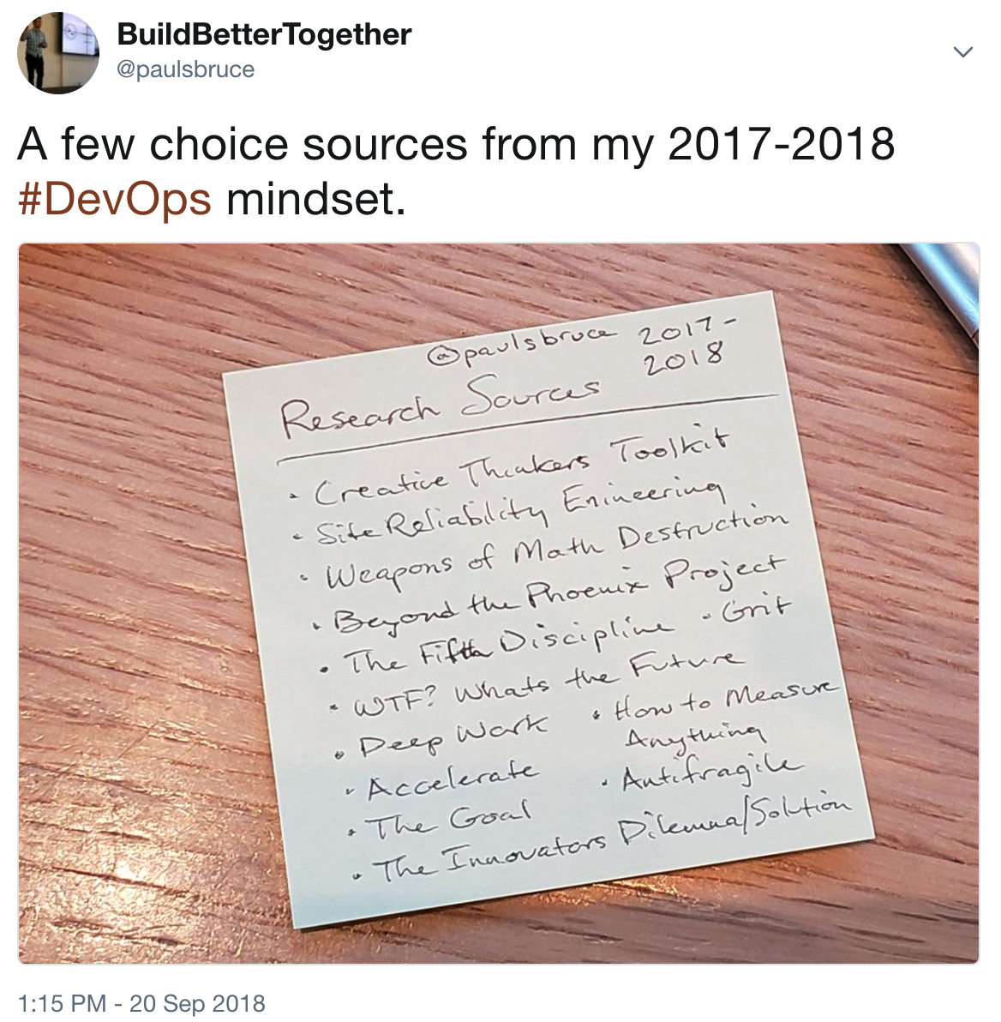
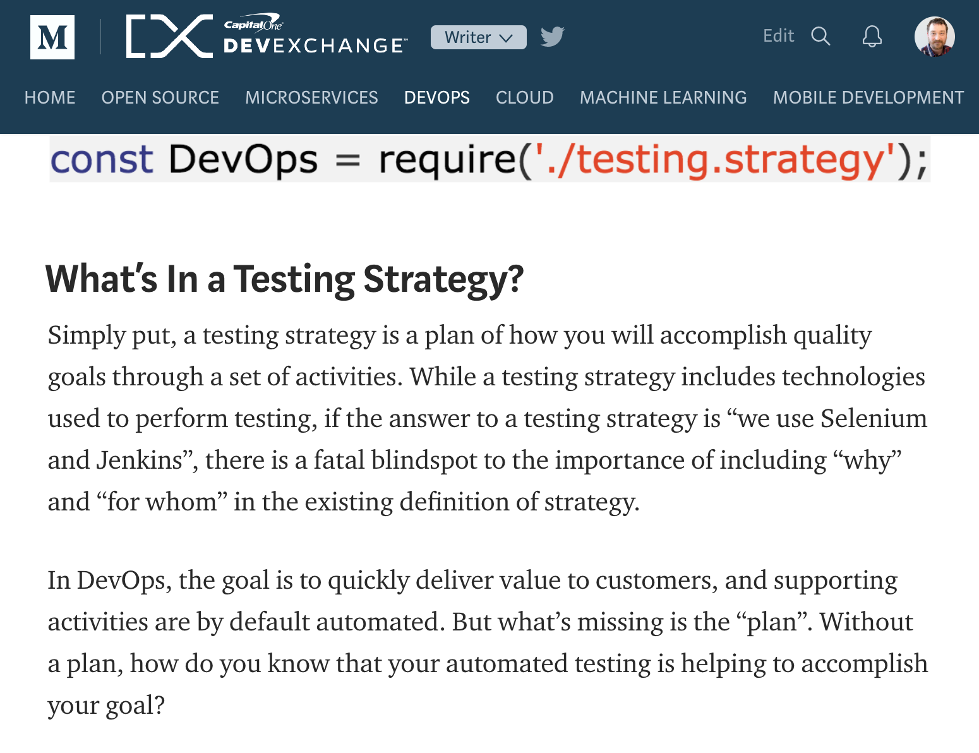
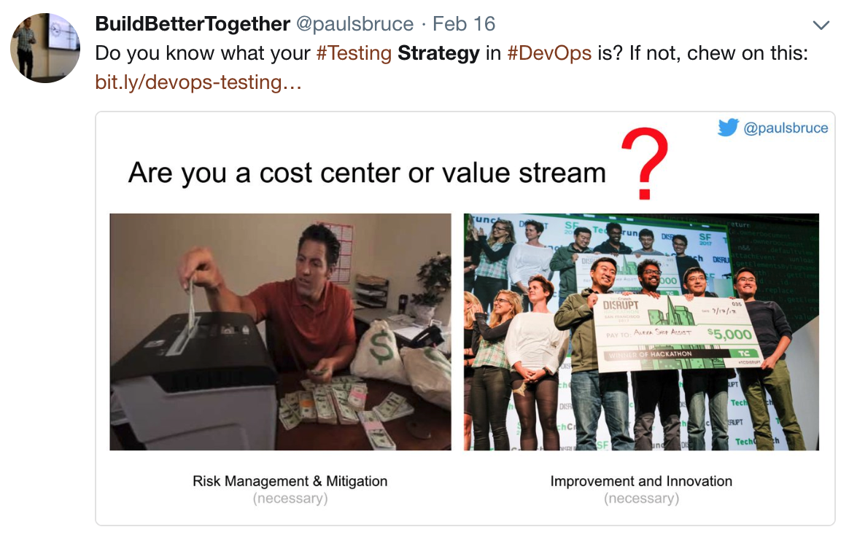

bit.ly/devops-testing-strategy
@paulsbruce
Notes:
https://twitter.com/paulsbruce/status/1042824562931511296
https://twitter.com/paulsbruce/status/964704210884485120

Slide 18
Paul Bruce @paulsbruce linkedin.com/in/paulsbruce paulsbruce.io Sr. Performance Engineer, Neotys Founder, Growgistics IEEE 2675 Working Group Product strategy, automation eng Boston DevOps, Mobile Tea, NADOG

Slide 21
Slides: bit.ly/addo18-progressive-testing

